Slide 1

Customer Shopping Behavior Analysis
3,900 purchases | 18 features | goal: reveal spending, segments, preferences, subscriptions

Slide 2

Dataset Summary
Rows & Columns
Key Features
3,900 rows · 18 columns
Demographics, purchase details, behavior, subscription
Missing Data
37 missing review ratings

Slide 3

Exploratory Data Analysis (Python)
Load & Inspect
df.info() · df.describe()
Clean & Impute
Imputed Review Rating by category median
Feature Engineering
age_group · purchase_frequency_days
Standardize
Renamed columns to snake_case

Slide 4
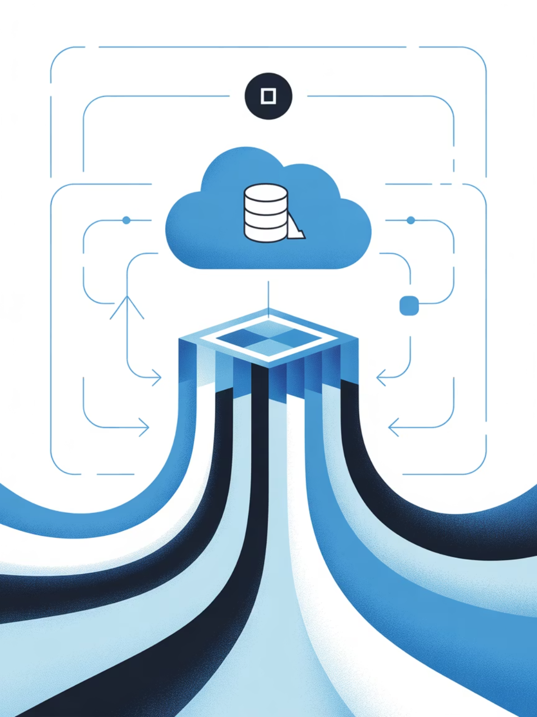
Database & SQL
Cleaned DataFrame loaded to PostgreSQL for business queries and reporting.
Drop Redundancy
SQL Analysis
Dropped promo_code_used (redundant with discount_applied)
Revenue, segments, top products, shipping comparison

Slide 5
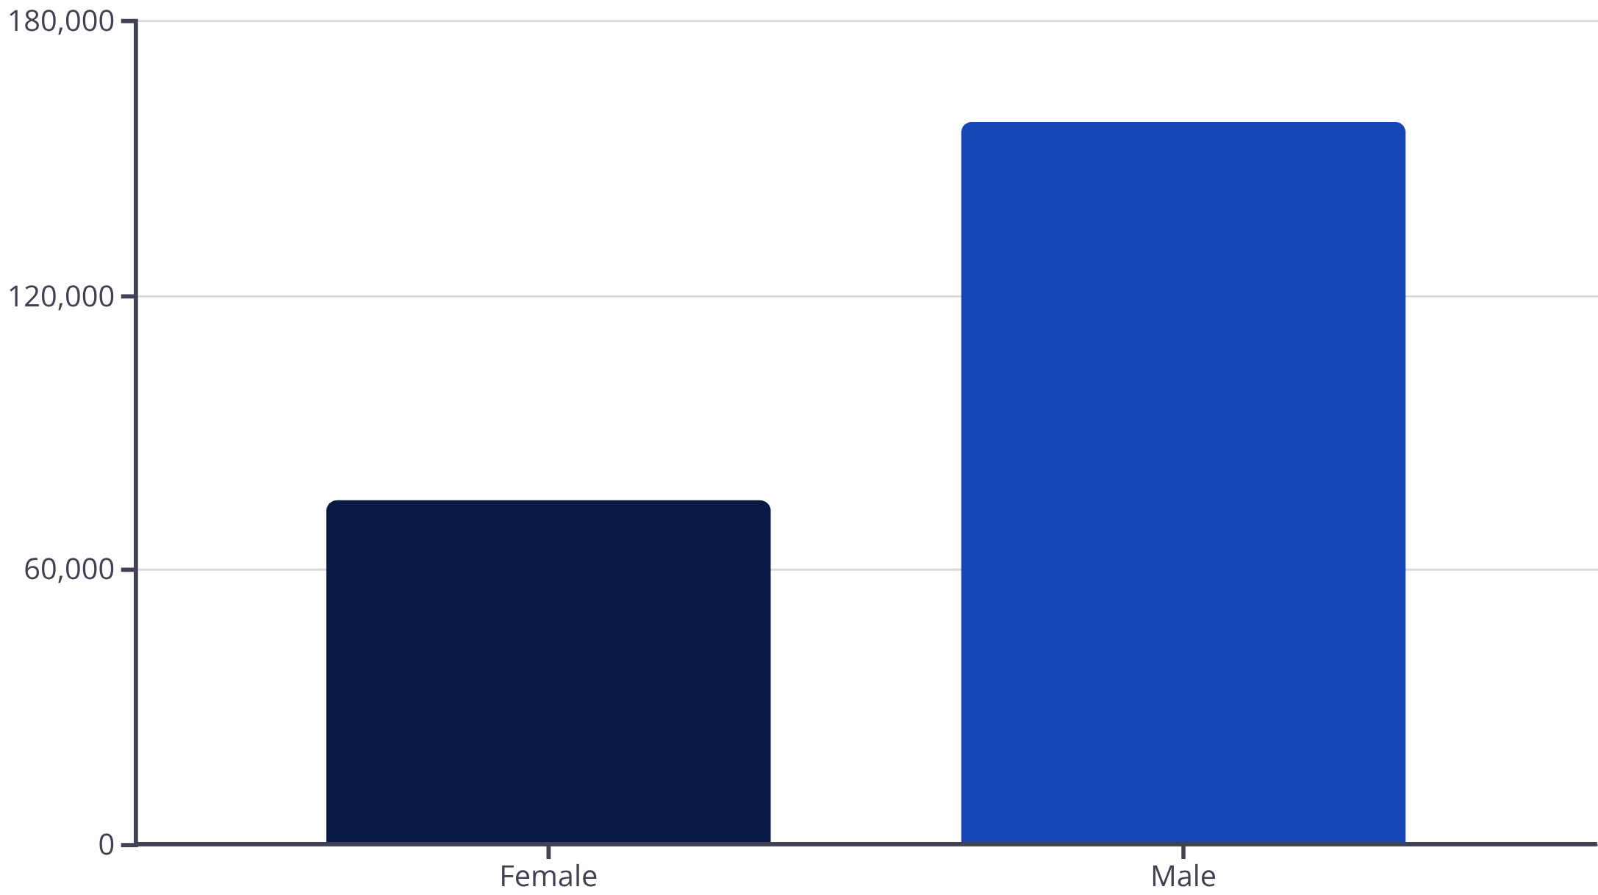

Revenue by Gender
Male customers generated higher total revenue
Use targeted offers to grow female revenue share

Slide 6
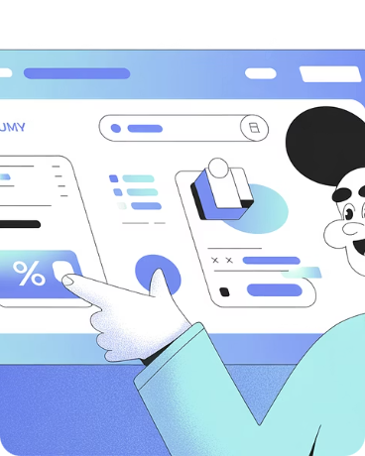
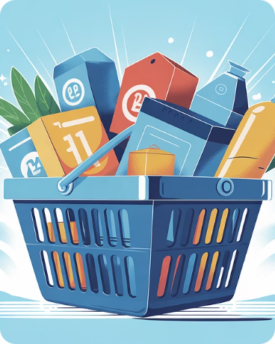
Discounts & High-Spenders
Discount Users
Top Cases
839 rows identified using discounts but spending above average
Examples show purchases (62–97 USD) despite discounts

Slide 7





Top Products & Reviews
Gloves
Sandals
Boots
Avg rating 3.86
Avg rating 3.84
Avg rating 3.82
Hat
Skirt
Avg rating 3.80
Avg rating 3.78

Slide 8
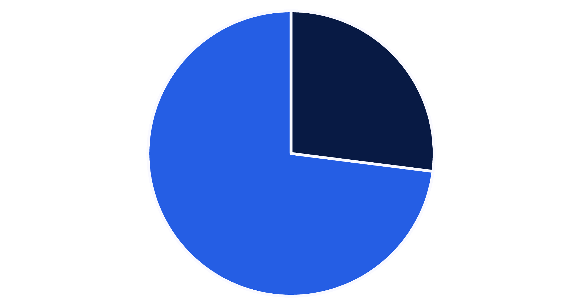
Subscribers vs Non-Subscribers
Subscribers: 1,053 · Avg spend $59.49 · Revenue $62,645
Non-subscribers: 2,847 · Avg spend $59.87 · Revenue $170,436
Boost subscriptions to increase recurring revenue
Yes
No

Slide 9
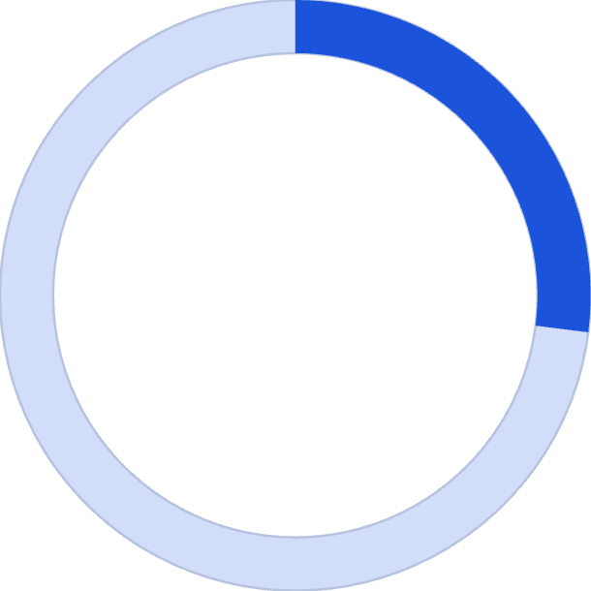

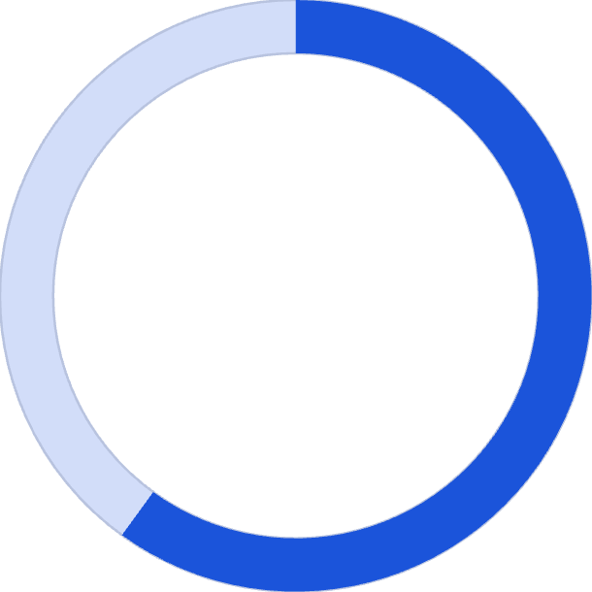
Sales & Revenue Highlights
27%
$100K
Subscribed
Clothing Revenue
Yes 27% · No 73%
Top category revenue
2,000
60K
Clothing Sales
Young Adult Revenue
Highest sales by units
Highest by age group

Slide 10
Business Recommendations
Boost Subscriptions
Loyalty Programs
Review Discount Policy
Promote exclusive subscriber benefits
Reward repeat buyers to grow 'Loyal' segment
Balance promotions with margin control
Product Positioning
Targeted Marketing
Highlight top-rated & best-selling items
Focus on high-revenue age groups & express-shipping users

